Slide 1
React Components

Slide 2
Agenda
In this session, we will discuss:
Introduction to React Components
Component Tree
Types of React Components
React Class Components
React Function Components
Introduction to JSX

Slide 3
Introduction to React Components
A React component is a self-contained module representing a part of the user interface.
Components are custom, reusable HTML elements that accept inputs (props) and return a tree of elements for the screen.
React components use JavaScript and JSX (a JavaScript syntax extension) to render HTML-like elements.

Slide 4
Introduction to React Components (Cont.)
App
Header
Side Bar
Main
1
2
3
4
Notes:
A React component is a self-contained module that represents a part of a user interface.
Components can be thought of as custom, reusable HTML elements that accept inputs (props) and return a tree of elements (the component's render method) that describe what should appear on the screen.
React components are defined using JavaScript and JSX (a syntax extension for JavaScript) and they render HTML-like elements.
The rendered elements can also include other React components, making it possible to build complex user interfaces by composing simple components.
React components allows for the creation of reusable and maintainable code.

Slide 5
Component Tree
One Way Binding
App
Side Bar
Main
Header
1
4
2
3

Slide 6
Types of React Components
React components are created using ES6(ECMAScript language specification) classes and JavaScript functions.
The two types of React components include:
Class components, which are defined using a class that extends React.Component and implements a render method that returns the tree of elements that represent the component's UI.
Function components are simple JavaScript functions that return the tree of elements representing the component's UI.
Function components are more popular these days as they are concise
and easy to create.

Slide 7
React Class Components
Components defined using ES6 (ECMAScript language specification, a standard for scripting languages like JavaScript) classes.
A class component in React is a JavaScript class that extends the base React.Component class.
Allows to manage more advanced features such as lifecycle methods and state.

Slide 8
React Class Components (Cont.)
Hands-on using VSCode
Go to "React Recording Content\week1-app\week1-app\src\components\02_React Components & JSX\1_Class based react component" to explain the Class components.

Slide 9
React Function Components
Components defined as JavaScript functions.
Initially react function components are stateless.
Unlike class components, functional components don't have access to lifecycle methods or state, but they still provide a way to render a user interface and handle events in React with the introduction of hooks (e.g., useState, useEffect).

Slide 10
React Function Components (Cont.)
Hands-on using VSCode
Go to "week1-app\week1-app\src\components\02_React Components & JSX\2_Function based react component" to explain the Function components.

Slide 11
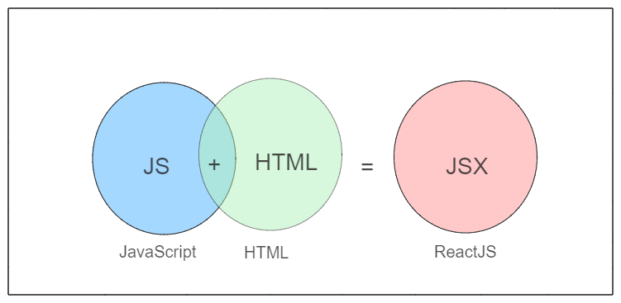
Introduction to JSX
JSX is a JavaScript syntax extension that allows writing HTML-like code within JavaScript.
Notes:
JSX is a syntax extension for JavaScript that allows for writing HTML-like code within the JavaScript code.
It was introduced by Facebook in 2011 and is used in React, a JavaScript library for building user interfaces.
With JSX, you can write the component’s UI using HTML-like elements, while still retaining the ability to use JavaScript to add dynamic behavior.
JSX is not part of the JavaScript language, but it gets transpiled (converted) to JavaScript code that can run in a browser or on a server.
This is usually done using a tool like Babel.
The resulting JavaScript code creates and updates the Document Object Model (DOM), which is the structure of elements that represents a web page.

Slide 12
JSX Example
Simple component written in JSX:
const element = <h1>Hello everyone !</h1>;
(Without JSX - in JavaScript)
const element = React.createElement("h1", null, " Hello everyone !");
Notes:
Here's an example of a simple component written in JSX:
const element = <h1>Hello, World!</h1>;
This code defines a constant element that contains a single HTML h1 heading element.
When transpiled to JavaScript, it becomes the following:
const element = React.createElement("h1", null, "Hello, World!");
In this way, JSX provides a concise and readable syntax for creating and manipulating HTML elements in JavaScript.
By using JSX, you can build complex user interfaces using a declarative style, which makes it easier to understand and maintain your code.

Slide 13
React Component with JSX
Hands-on using VSCode
Go to "React Recording Content\week1-app\week1-app\src\components\02_React Components & JSX\3_React component using JSX".

Slide 14
React Component with JSX
Hands-on using VSCode
Go to "week1-app\week1-app\src\components\02_React Components & JSX\4_React component without using JSX".

Slide 15
Summary
Here's a brief recap:
React components are the building blocks of a React application and play a crucial role in making the development process simpler, faster, and more efficient.
JSX makes it easier to write UI components and allows for a more readable and concise way of writing code for user interfaces.

